Slide 1
Timeline Infographics
Phase 01.
Mercury is a small planet
Phase 02.
Jupiter is a gas giant
Here is where this template begins
Phase 03.
Mars is actually very cold
You are here
This template has been created by Slidesgo

Slide 2
Timeline infographics
Jupiter is a gas giant and the biggest planet of them all
Let’s take a look at Mars
Despite being red, Mars is cold. It’s full of iron oxide dust, which gives the planet its reddish cast
Phase 01.
Phase 02.
Current milestone
Let’s learn about Mercury
Mercury is the closest planet to the Sun and the smallest one in the entire Solar System
Venus is the second planet from the Sun. It has a nice name
This template has been created by Slidesgo

Slide 3
Timeline infographics
Venus is a hot planet
03.
Saturn has several rings
Despite being red, Mars is actually a very cold place. It’s full of iron oxide dust
02.
Jupiter is a huge gas giant and the biggest planet in the entire Solar System
01.
Mercury is the closest planet to the Sun and the smallest one of them all
This template has been created by Slidesgo

Slide 4
Timeline infographics
January
February
March
April
Mars
Venus
Jupiter
Earth
Despite being red, Mars is actually a cold place. It’s full of iron oxide dust
Venus is the second planet from the Sun. It has a beautiful name and is hot
Jupiter is a huge gas giant and the biggest planet in the entire Solar System
Earth is the third planet from the Sun and the only one known that has life
Today: March 07th
This template has been created by Slidesgo

Slide 5
Timeline infographics
 | Q1 |  |  | Q2 |  |  | Q3 |  |  | Q4
 | Jan | Feb | Mar | Apr | May | Jun | Jul | Aug | Sep | Oct | Nov | Dec
Mercury is the smallest planet in the entire Solar System
Venus is the second planet from the Sun and is very hot
Earth is the third planet from the Sun and harbors life
Despite being red, Mars is actually a very cold place
Jupiter is a huge gas giant and the biggest planet of them all
Title of the project
Saturn has several rings
This template has been created by Slidesgo

Slide 6
Timeline infographics
Week 01.
Week 02.
Week 03.
Mars
Mercury
Jupiter
List your tasks here
List your tasks here
List your tasks here
List your tasks here
List your tasks here
List your tasks here
List your tasks here
List your tasks here
List your tasks here
Week 04.
Week 05.
Week 06.
Neptune
Venus
Earth
List your tasks here
List your tasks here
List your tasks here
List your tasks here
List your tasks here
List your tasks here
List your tasks here
List your tasks here
List your tasks here
Completed
Not completed
This template has been created by Slidesgo

Slide 7
Timeline infographics
Mars
01.
02.
Mercury
Despite being red, Mars is actually a very cold place. It is full of iron oxide dust
Mercury is the closest planet to the Sun and the smallest one in the entire Solar System
Mercury is the smallest planet in the Solar System
Earth
04.
03.
Venus
Earth is the third planet from the Sun and the only one known that harbors human life
Venus is the second planet to the Sun. It has a beautiful name but also high temperatures
Up to now
This template has been created by Slidesgo

Slide 8
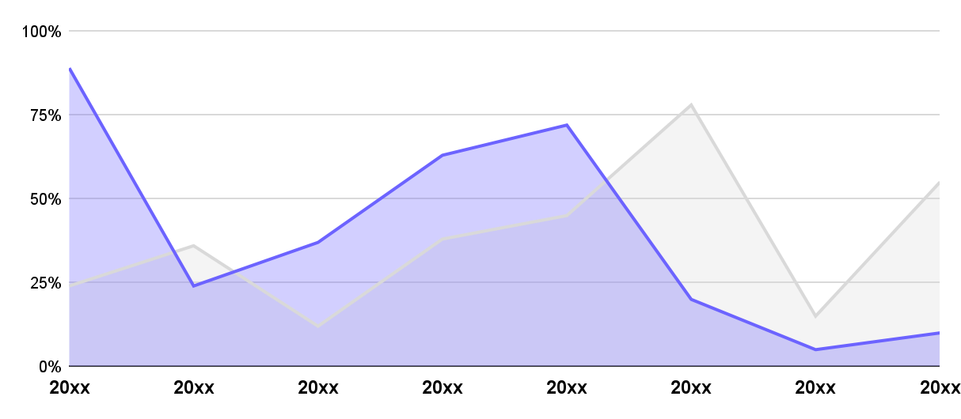
Timeline infographics
Mercury
Earth
Mercury is the smallest planet of them all
Earth is the only planet known that harbors life
20xx
24%
89%
20xx
36%
24%
20xx
12%
37%
20xx
38%
63%
20xx
45%
72%
20xx
78%
20%
Follow the link in the graph to modify its data and then paste the new one here. For more info, click here
20xx
15%
5%
Highest value
Lowest value
20xx
55%
10%
This template has been created by Slidesgo

Slide 9
Timeline infographics
Mars
Mercury
Venus
Despite being red, Mars is actually a very cold place
Mercury is the smallest planet in the Solar System
Venus is the second planet from the Sun and is very hot
List your tasks here
List your tasks here
List your tasks here
List your tasks here
List your tasks here
List your tasks here
List your tasks here
List your tasks here
List your tasks here
List your tasks here
List your tasks here
List your tasks here
List your tasks here
List your tasks here
List your tasks here
20%
60%
100%
of progress
of progress
of progress
This template has been created by Slidesgo

Slide 10
Timeline infographics
Mercury
Venus
Mars
Earth
Mercury is the closest planet to the Sun and the smallest one
Venus is the second planet from the Sun and has a nice name
Despite being red, Mars is actually cold. It’s made of basalt
Earth is the third planet from the Sun and has human life
Now
Week 01.
Week 02.
Week 03.
Week 04.
Week 05.
This template has been created by Slidesgo

Slide 11
Timeline infographics
Despite being red, Mars is actually a very cold place. It is full of iron oxide dust, which gives the planet its reddish cast
20xx
Saturn
Neptune is the farthest planet from the Sun
20xx
Mercury
20xx
Earth
Mercury is the smallest planet in the Solar System
Earth is the third planet from the Sun and has life
20xx
Venus
20xx
Jupiter
Venus is the second planet from the Sun and is hot
Jupiter is a huge gas giant and the biggest planet
This template has been created by Slidesgo

Slide 12
Instructions for use
If you have a free account, in order to use this template, you must credit Slidesgo in your final presentation.
As a Free user, you are allowed to:
Modify this template
Use it for both personal and commercial projects
You are not allowed to:
Sublicense, sell or rent any of Slidesgo Content
Distribute Slidesgo Content unless it has been expressly authorized by Slidesgo
Include Slidesgo Content in an online or offline database or file
Offer Slidesgo templates (or modified versions of Slidesgo templates) for download
Acquire the copyright of
Slidesgo Content
For more information about editing slides, please read our FAQs or visit our blog

Slide 13
Instructions for use (premium users)
As a Premium user, you can use this template without attributing Slidesgo
You are allowed to:
Modify this template
Use it for both personal and commercial projects
Share this template in an
editable format
Hide or delete the “Thanks” slide and the mention to Slidesgo in the credits
You are not allowed to:
Sublicense, sell or rent any of Slidesgo Content
Distribute Slidesgo Content unless it has been expressly authorized by Slidesgo
Use any of the elements that are part in a separated way
Register any of the elements as a trademark or logo in an intellectual property registry
For more information about editing slides, please read our FAQs or visit our blog

Slide 14
Infographics
You can add and edit some infographics to your presentation to present your data in a visual way.
Choose your favourite infographic and insert it in your presentation using Ctrl C + Ctrl V or Cmd C + Cmd V in Mac
Remember to choose the “Keep source formatting” option so that it keeps the design. For more info, please visit our blog
01
07
Select one of the parts and ungroup it by right-clicking and choosing “Ungroup”
Repeat the steps above with the other parts and when you’re done editing, copy the end result and paste it into your presentation
02
06
03
Change the color by clicking
on the paint bucket
05
Group the elements again by selecting them, right-clicking and choosing “Group”
Then resize the element by clicking and dragging one of the square-shaped points of its bounding box (the cursor should look like a double-headed arrow). Remember to hold Shift while dragging to keep the proportions
04

